Slide 1

Predicting Diabetic using Machine Learning: A Comparative Study of Algorithms
ISM 6359: Data Mining
Yayuan Zhang

Slide 2


Overall Analysis Process
PyCharm & Jupyter
Read in the Data
Relevent features
Relationship
Data type
Statistic values
Outliers
Missing values
Data Preparation
Feature engineering
Outlier detection
Replace missing values
Transformation
EDA
Heatmap
Pie
Bar plot
Histogram
Scatter
Box plot
Model selection
Random Forest
Decision Tree
KNN
Logistic Regression
SVC - linear
SVC - rbf
Train & Test
& Evaluation
70% train set
Confusion Metrix
Accuracy
AUC ROC
Overfitting
Deep learning
Tweaking parameters
RandomForest
SearchCV
GridSearchCV
Increased
Accuracy
Increased
AUC-ROC
Increased
F1-Score
Modeling
Data Understanding
Data Preparation
Modeling
Tweaking Parameters
3W

Slide 3

N
ational Institute of Diabetes and Diagestive and Kidney Diseases & Published on Kaggle
C
ontains 768 data points 9 features
E
ach row represents basics info: pregnancy, blood glucose, blood pressure, skin thickness, insulin, BMI, Age, etc
34.9% of people have Diabetes
All variables display positive distribution
There is not highly correlated feature with Diabetes
Data Understanding
Data Preparation
Modeling
Tweaking Parameters
3W

Slide 4
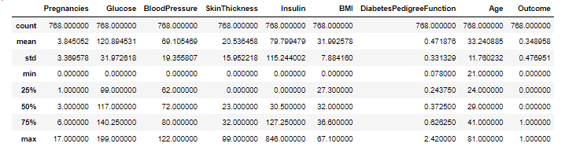
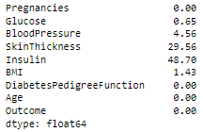
Replacing missing values
Outlier & Scaler
Zero values Analysis
Pregnancy can be 0
Outcome is targeting variable with value 0 & 1
Glucose, Blood Pressure, Skin Thickness, Insulin, BMI cannot be zero
High percentage in its columns
Solution: filling the median values of the feature
Pregnancy – Max value = 17
Leave the data unchanged and scale the data
Solution: StandardScaler()
Data Understanding
Data Preparation
Modeling
Tweaking Parameters
3W

Slide 5
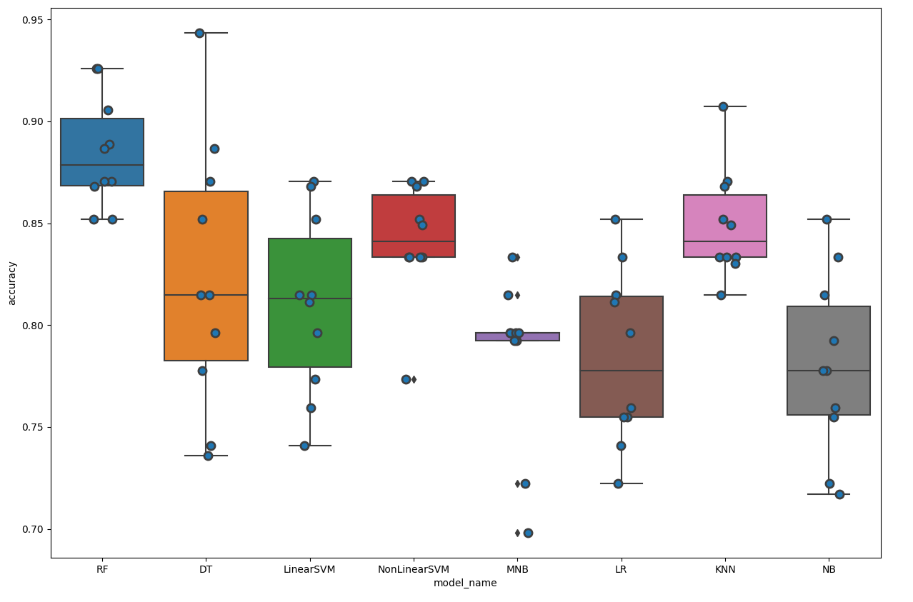
Model Selection
Random Forest
Non Linear SVM SVC (kernel=rbf)
Decision Tree
Linear SVM SVC (kernel=linear)
MNB
Logistic Regression
Gaussian NB
K-Folds Cross-validation method
K = 10
Data Understanding
Data Preparation
Modeling
Tweaking Parameters
3W

Slide 6
Tweaking parameters process
Random Forest Model
SVC (Kernel = ‘rbf’)
RandomizedSearchCV()
GridSearchCV()
Set up a range for each parameter
Set up a range for each parameter
K-Folds Cross Validation: 10
K-Folds Cross Validation: 10
Search the best combination of parameters with high accuracy
Search the best combination of parameters with high accuracy
Fit the best combination into model
Fit the best combination into model
Data Understanding
Data Preparation
Modeling
Tweaking Parameters
3W

Slide 7
Tweaking parameters for Top 1 & 2 model
Random Forest Model
SVC (Kernel=‘rbf’)
Before
Accuracy | 0.87
F1 score | 0.82
After
0.88
0.83
Before
Accuracy | 0.81
F1 score | 0.73
After
0.83
0.75
AUC-ROC | 84.60
86.46%
AUC-ROC | 74.72%
80.47%
Comes from the Test set
Data Understanding
Data Preparation
Modeling
Tweaking Parameters
3W

Slide 8

What went well?
Data mining process
Data
Model
Programming environment
Find available dataset
Tweaking parameters
Random Forest
Replace missing value
Split train & test set
Analysis missing values
Build model & evaluation
Data understanding
K-folds cross validation
Data Understanding
Data Preparation
Modeling
Tweaking Parameters
3W

Slide 9
What did not go well?
Ignored Outliers
Overfitting
Tweaking parameters
Have to go back and revisit the data
Both Models
SVC
Extra work
Perfect accuracy but poor performance on test set
Set too large range
Pregnancies: max = 17
Tweaking parameters
Run slowly
Almost half of the whole project time
Data Understanding
Data Preparation
Modeling
Tweaking Parameters
3W

Slide 10
What I would do differently next time?
Spend more time on data preparation
Tweaking parameters
Check missing value, i.e., =0/NaN
More patience
Check Outliers carefully
No rush
More difficult to understand & correct after data has been removed from original
Don’t set wide ranges of parameters
Spend 50% - 80% of time = useful nuggets
Set aside some time for this part
Data Understanding
Data Preparation
Modeling
Tweaking Parameters
3W

Slide 11
Thank you for watching!

